Slide 1



PROBLEM TREE + 5 WHYs?
HOW TO USE?
BOOTCAMP ONE | DAY TWO
HCD EXERCISE | FOUNDATION
UNDERSTAND THE PROBLEM OR OPPORTUNITY
2
Effects
Note down: The effects and signs that qualify the problem or opportunity.
Objective of Exercise
To establish a primary understanding of the elements of a problem or opportunity. To identify effects and causes that inform the identification of themes / lines of inquiry for research in the Discovery phase.
Tool
Problem Tree + 5 Whys?
About ‘Problem Tree’
The tool has three parts - the Trunk/Core (problem/opportunity), the Branches (effects/signs), and the Roots (causes/reasons). While traditionally the tool is looked only through a problem lens, we can also use it to appreciate opportunities.
About ‘5 Whys?’
A tool that is a series of questions that helps us get to the root cause of something. It is used as a complementary tool to the problem tree.
Effect
Effect
Effect
Effect
Effect
Effect
1
1
Effect
Effect
Effect
Problem or Opportunity
Note down: The main problem or opportunity that you are looking to work on.
Problem
Problem
Problem
Cause
Cause
Cause
Cause
Root Cause
Cause
Cause
Root
Cause
Root Cause
3
Root
Cause
Cause
Causes
Note down: The causes or reasons that make it a problem or an opportunity.
Cause
Root
Cause
Cause
Root
Cause
Root
Cause
*
5 Whys?
To really get into the depth (or root cause/reason) of what makes something a problem or opportunity, we can use the 5 Whys? tool. Keep asking why? until you feel that you have a strong enough root cause.
THE FINLAB TOOLKIT

Slide 2
TOOL: PROBLEM TREE + 5 WHYs?
THE FINLAB TOOLKIT

Slide 3
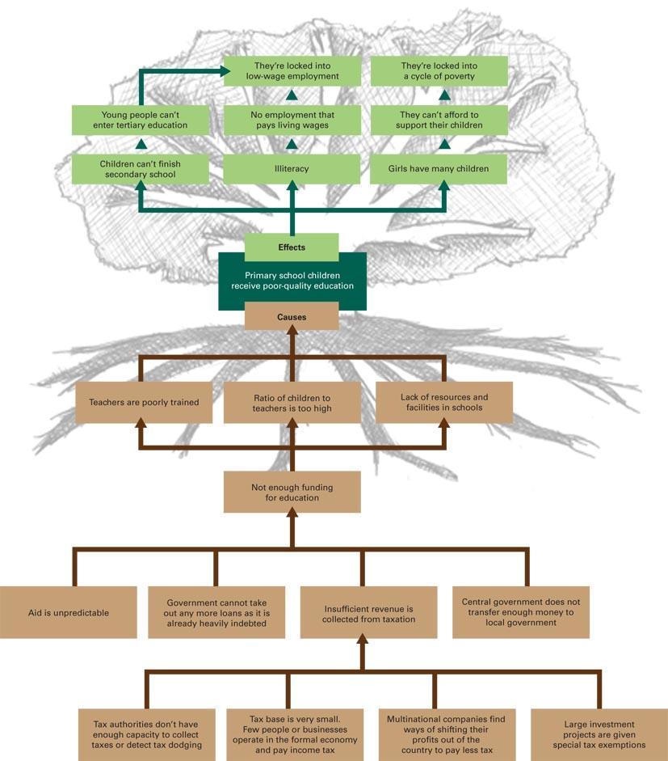
TOOL: PROBLEM TREE + 5 WHYs?
THE FINLAB TOOLKIT

Slide 4
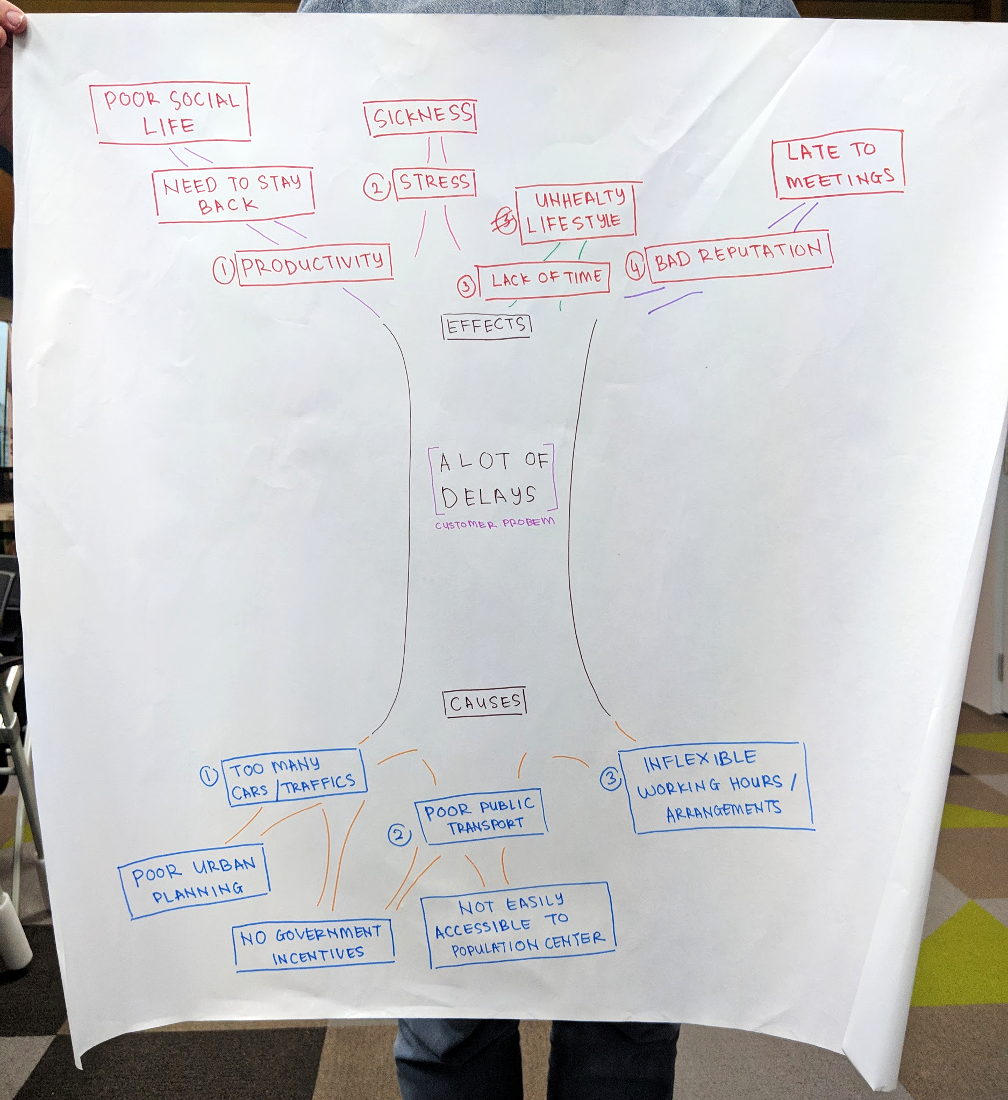
TOOL: PROBLEM TREE + 5 WHYs?
THE FINLAB TOOLKIT

